Slide 1

“JobsPyMatcher”: Targeted Resume Optimization for Job Descriptions
Team Noobs:
Aanal Patel
Bimal Shrestha
Danilo Diaz
Ernie Sumoso
Jayachandhran Saravanan

Slide 2



Problem Statement
Over 75% of resumes get discarded by the ATS, before any recruiter ever opens and evaluates their applications (Kick jobs, 2024).
This gives no room for errors during the first impression to the employers: the resume.
Business Value
Job Applicants
Mainly targeted to job applicants:
Job Applicants: will find a centralized tool for resume optimization with multiple helpful features. They will be able to enhance their resume iteratively, crafting a final outstanding resume specifically targeted for the input job description.
Our Goal
Develop a fully fledged application where users can upload their resumes and target job description. Then, we will offer various features with the sole purpose of significantly improving their resume.
RESUME

Slide 3




Our data
2,484 resumes from 24 industries in PDF
13,547 job descriptions from same 24 industries
228 resumes from unknown industries in Word
We developed a web scrapper to extract the job descriptions from Indeed Canada (project hosted on GitHub).

Slide 4
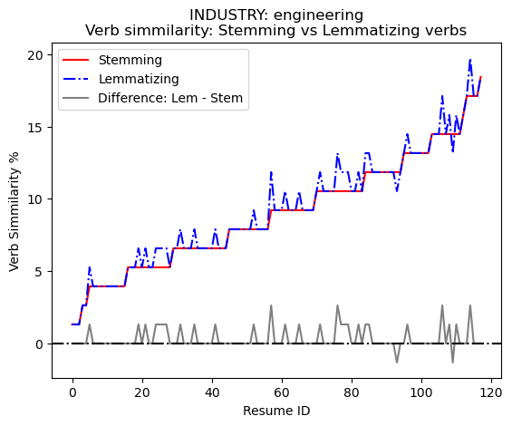
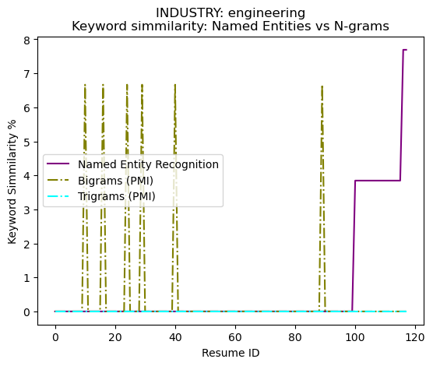
Text Processing
Text wrangling/cleaning
Removing stop words → word tokenization
Number removal → regex patterns
Punctuation removal → string methods
Whitespace removal → regex patterns
Identifying Verbs similarity, common & lacking verbs
Identifying POS tags
Stemming
☆ Lemmatization ☆
Recommending ranked action verbs
Synonyms → WordNet & Synsets
Similarity between words → Synsets
Identifying Keywords: similarity, common & lacking
Named Entity recognition
Word Collocations: Bigrams → PMI and likelihood ratio
Word Collocations: Trigrams → PMI and likelihood ratio

Slide 5
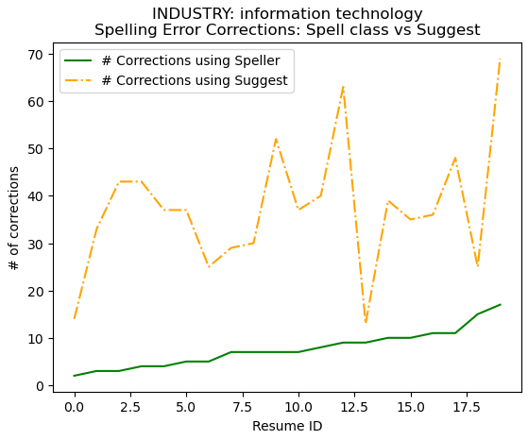
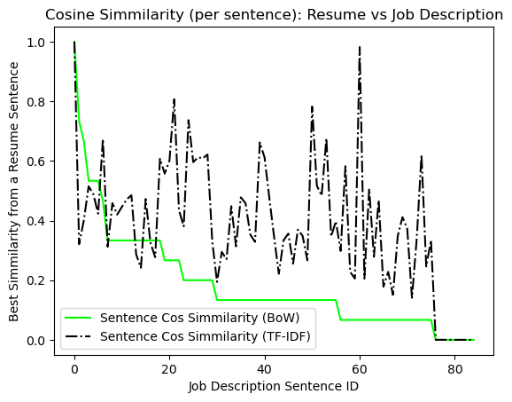
More Features
Correcting Spelling errors from resume
Spell class → autocorrect library
☆ Suggest function ☆ → pattern library
Resume Sentiment Analysis
Identifying negative sentences → Vader Sentiment
Calculating Resume vs Job Description similarity
For each job description sentence:
Match the best resume sentence
Vectorize texts
Bag of Words
☆ TF-IDF ☆
Cosine Similarity

Slide 6
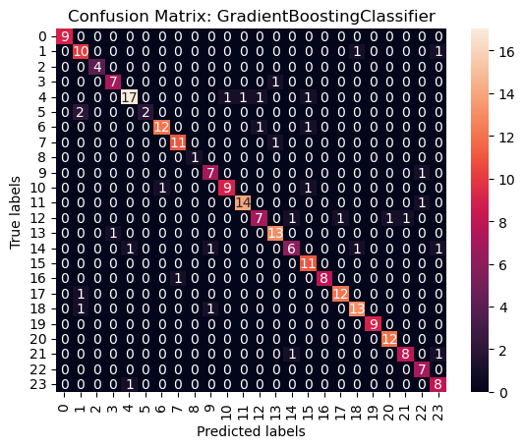
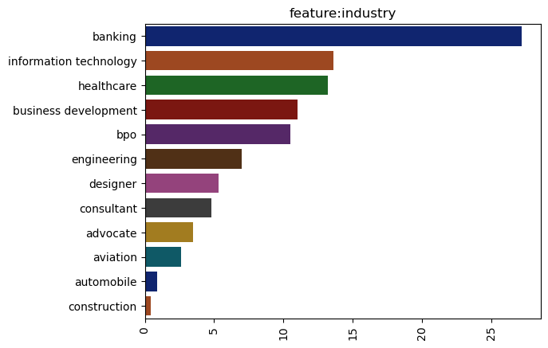
Classification models
Classifying resumes into industries
Feature extraction → NLTK FreqDist
Label encoding resume dataset
Split into train, test, & evaluation
Multi-class Classification models
KNN
☆ Random Forest ☆
☆ Gradient Boosting ☆
Naive Bayes
Hyper-parameter tuning
Grid Search CV
Train (≈65%) Test (≈62-64%)
Comparing models
Accuracy Score
F1-Score
Confusion Matrixes
Evaluating models
Best model → Gradient Boosting (≈87%)
Labeling new unknown data
224 resumes in Word format

Slide 7

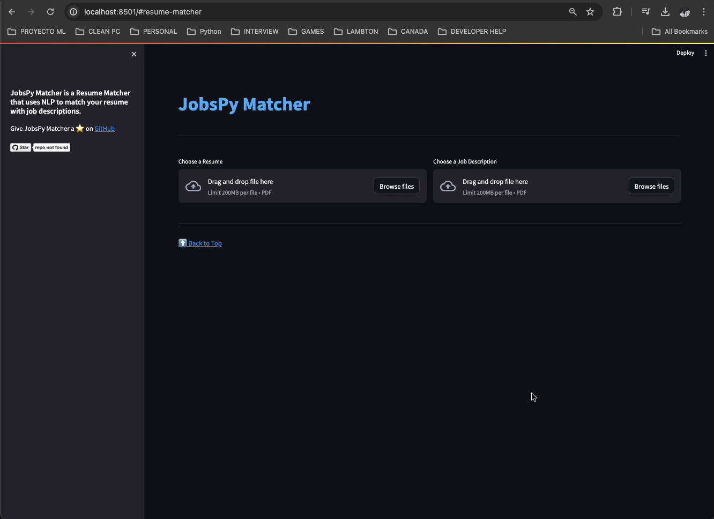
“JobsPyMatcher”: Improve your resume now

Slide 8

Resources
Thanks!
Do you have any questions?
Diaz, D. (April 2024). GitHub - NILodio/ JobsPyMacher at master. GitHub. https://github.com/NILodio/JobsPyMacher
Indeed. (January 3, 2023). 15 resume mistakes to avoid. Indeed. https://www.indeed.com/career-advice/resumes-cover-letters/15-resume-mistakes-to-avoid
Jobs, K. (February 19, 2024). 76% of resumes are discarded because of this mistake. https://www.linkedin.com/pulse/76-resumes-discarded-because-mistake-kick-jobs-5ui2f/
Paulise, L. (February 20, 2024). How to Update your resume Harnessing the power of AI. Forbes. https://www.forbes.com/sites/lucianapaulise/2023/11/14/50-of-the-resumes-are-updated-harnessing-the-power-of-ai/?sh=4798966840f9
Thompson, N. (August 10, 2023). How to quantify resume using data, metrics, and numbers. https://www.tealhq.com/post/quantify-your-resume

